Slide 1
Mortgage Insurance Cross Sell Case Study
By Jayant Kodwani
Notes:
5/13/2022 10:20 AM
1
© Microsoft Corporation. All rights reserved. MICROSOFT MAKES NO WARRANTIES, EXPRESS, IMPLIED OR STATUTORY, AS TO THE INFORMATION IN THIS PRESENTATION.

Slide 2
THE CURRENT STATE AND GOALS
Insights:
42% of the overall consumers do not have any PPI product.
~2/3 of the overall PPI Consumers held a single PPI insurance product whereas rest 1/3 of the PPI consumers held a Joint or LCI insurance.
Goals (*Pure Assumption here but can be tweaked after discussions with marketers/stakeholders):
The desired state would be to cross sell the PPI insurance to these 42% potential audience and convert half of them ~21% (3400) to a PPI Consumer in the given fiscal year.
Further, goal setting can be done basis the PPI types i.e., increase the share of Joint consumers from 13% to 25%

Slide 3
THE FACTORS
Majority of the current PPI Consumer base ~93% belongs to the credit score category of 601-1000. The potential target audience for the cross-sell campaign should focus on this credit score category.
The proportion of overall as well as PPI consumers is more favored to the male consumers with a share of 59% vs female share of 41%. Gender alone does not seem to have a significant impact on PPI consumerism; however a deeper correlation study may be required to combine gender with other factors such as Marital Status, # of dependents, time with bank.
Interestingly, majority of the PPI consumers fall into bank tenure category of 100-200 and 200-300, The potential target audience for the cross-sell campaign should focus on this 100-300 bank tenure category.

Slide 4
THE STRATEGY
Consumers with income range 6 and 4 are more likely to become PPI consumers as compared to other income ranges.
Majority of the current PPI Consumer base has outstanding mortgage between 0-100k. The potential target audience for the cross-sell campaign should focus on this 0-100k outstanding mortgage category.

Slide 5
THE STRATEGY
Step 1
Identify all potential consumers based on below criteria:
Step 3
Optional (Use discount schemes based on credit score, income , age etc.)
Step 4
Measure the impact of discount schemes on # of consumers added through discounts vs non discounts.
Step 5
Track the improvement via monthly/quarterly reviews.
Step 6
Monitor and track goals and take corrective actions for training the analytics model and marketing strategy
Target these consumers with best performing content, emails, marketing advertisement campaigns to bring them into the marketing funnel and lead stage
Step 2
Credit Score = 601-1000,
Bank Tenure Category= 100-300,
Income Ranges 6,4,
Outstanding mortgage between 0-100k
Notes:
5
5/13/2022 10:20 AM
© Microsoft Corporation. All rights reserved. MICROSOFT MAKES NO WARRANTIES, EXPRESS, IMPLIED OR STATUTORY, AS TO THE INFORMATION IN THIS PRESENTATION.

Slide 6
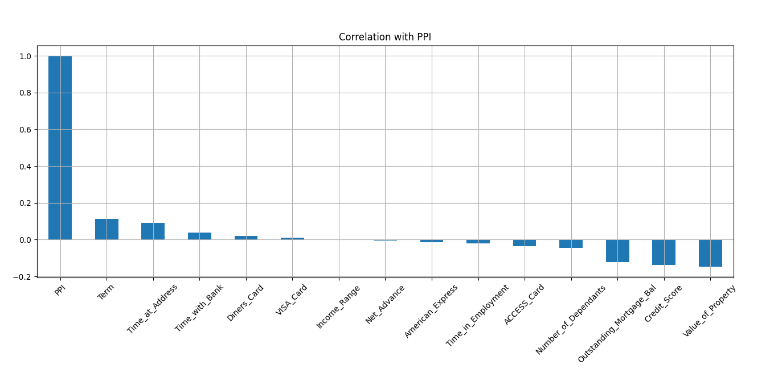
THE CORRELATION STUDY
The correlation study shows that Term, Time at Address, Time with Bank and certain card types shown a weaker association with the PPI (positive correlation b/w 0-0.2).
Notes:
*Refer to Python Script Below
import pandas as pd
import seaborn as sns
import matplotlib.pyplot as plt
df = pd.read_excel (r'C:/Users/jayan/Downloads/Case Study Data.xlsx', sheet_name='Data’)
df2 = pd.DataFrame(df[['PPI','Credit_Score','Credit Score Category' ,'Final_Grade','Term','Term Category','Net_Advance','Loan_Type','Time_at_Address','Residential_Status','Number_of_Dependants','Marital_Status','Gender','Time_in_Employment','Employment_Status','Income_Range','ACCESS_Card','VISA_Card','American_Express','Diners_Card','Cheque_Guarantee','Time_with_Bank','Value_of_Property','Outstanding_Mortgage_Bal']])
# Correlation matrix to 1-D Series
df2.corrwith(df2['PPI']).sort_values(ascending=False).plot.bar(
figsize=(16,9),title='Correlation with PPI',rot=45,grid=True
)
plt.show()

